Slide 1
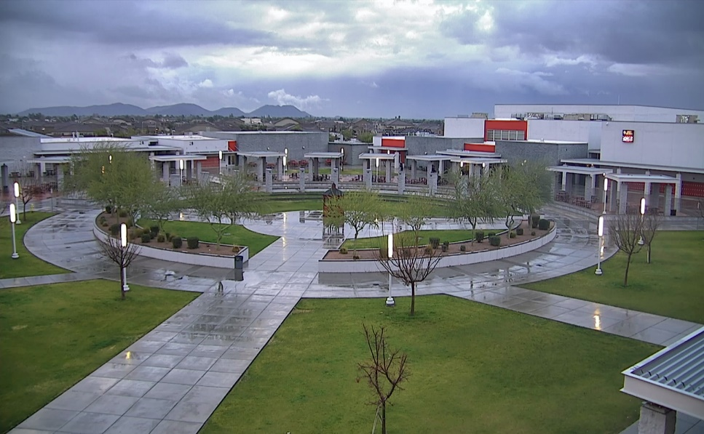
WELCOME TO LIBERTY
Home of the Lions
Please fill out the top of the registration form and sign bottom.
Look through the electives page and rank order 5-6 elective
classes that are of interest to you.
The power point will walk you through the rest of the form.

Slide 2
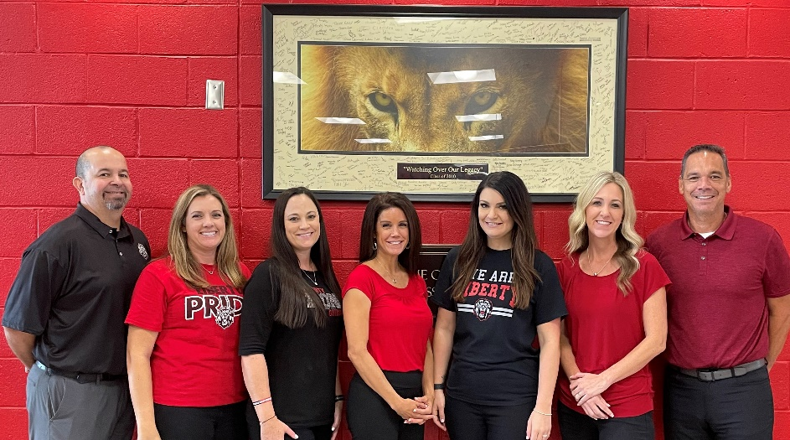
Liberty COUNSELORS
Each student will be assigned a counselor.
Counselors work in three Domains:
Academic Planning
Social/Emotional
Career/College Planning
Liberty also has a Career Center on Campus!
Notes:
We keep siblings together w/ same counselor.
You will have the same counselor for all of HS; will be able to see in Student Vue after schedules are made.
The LHS Guidance Department is located in the front office.

Slide 3
Explain block scheduling.
Identify the Graduation Requirements.
Explain the different levels of academic core classes.
Pick elective classes and turn in registration form to a Counselor.
Objectives
for Today:

Slide 4
Traditional Scheduling
Period 1 – English 1-2 Period 2 – Biology 1-2 Period 3 – Art 1 Period 4 – Lunch Period 5 – Algebra 1-2 Period 6 – PE/Health Period 7 – Intro to Computers
Yearlong Classes
Block Scheduling
Semester Classes
8 credits a year
Fall Semester
Period 1 – English 1 Period 2 – Computer Programming Period 3 – Lunch Period 4 – PE Period 5 – Algebra I
Spring Semester
Period 1 – Business Foundations Period 2 – Biology Period 3 – Geometry Period 4 – Lunch Period 5 – Mixed Choir
Notes:
The Peoria Unified School District is on Block Scheduling. Students have 4 classes per semester and 8 total for the school year. Each class is 90 minutes in length.

Slide 5
Advantages to block scheduling:
More time on 90 minute schedule for guided practice
More time in class for homework, feedback, help, etc.
Fewer classes a day to study/focus on
Easier to balance time for extra-curricular activities (sports & clubs)
More classes over a 4 year span = MORE CAREER EXPLORATION
6 credits x 4 years = 24 credits
8 credits x 4 years = 32 credits
Notes:
Students can earn up to 32 credits by the time they graduate but only need 28 to graduate.

Slide 6
Diploma Coursework – Required Credits
Courses​ | Graduation Requirements​ | University Requirements
English​ | 4​ | 4​
Mathematics​ | 4​ | 4​
Science (Lab)​ | 3​ | 3​
Social Studies​ | 3​ | 2​
Physical Education​ | 1​ | 0​
CTE / Fine Arts​ | 1​ | 1​
World Language​ | 0​ | 2​
Required Core Classes​ | 16​ | 16​
Elective Credits​ | 12​ | _
TOTAL CREDITS​ | 28​ | 28​
Notes:
Students must earn 28 credits for graduation. Please note the difference in graduation requirements verses University entrance requirements. The main difference is the World Language requirement and Universities usually require all C’s or better in the 16 core classes.

Slide 7
HONORS & AP Classes Available
English
Math
Science
Social Studies
World Languages
Electives
* Dual Enrollment OR college credit available in some classes
Notes:
Liberty High School does offer honors classes as well as dual enrollment opportunities. Dual enrollment (DE) information is provided by the teacher once the student is enrolled in a DE class.

Slide 8
LeT’s talk about YOUR SCHEDULE!
- 9th graders will take 8 classes/credits their freshman year ~ 4 per semester
- All freshmen must take: English, Biology, P.E., and two semesters of math. All 9th graders will take math all year.
- Most classes are one semester long for a full credit (90 minutes)
Notes:
Freshmen must take the following: English, Biology, Physical Education and Math (both semesters).

Slide 9
Sample Schedule A:
1st Semester
1st Per – Intro to Film
2nd Per – Algebra I Yearlong
3rd Per – Lunch
4th Per – Biology
5th Per – PE
2nd Semester
1st Per – Business Foundations
2nd Per – Algebra I Yearlong
3rd Per – English I
4th Per – Lunch
5th Per – Marketing
Notice –
- Math Placement goes all year
- Different lunches each semester
- Core classes split between semesters
- 3 electives
Notes:
Notice the four classes per semester
Math is BOTH semesters
This student has a different lunch each semester
Notice most classes (except math in this example) ONLY LAST 1 semester

Slide 10
Sample Schedule B:
1st Semester
1st Per – Marching Band
2nd Per – Algebra I (block)
3rd Per – Lunch
4th Per – Spanish I
5th Per – English I Honors
2nd Semester
1st Per – Spanish II
2nd Per – Geometry Honors
3rd Per – Lunch
4th Per – Biology
5th Per – Marketing
Notice –
- Math Placement changes at semester
- Same lunch all year
- Spanish I and II take up 2 of 3 elective spots

Slide 11
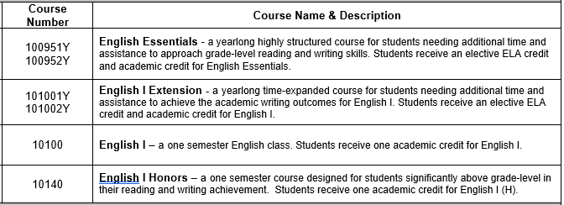
Choosing AN english Class
Notes:
Choosing your English placement:
In the Peoria School District the 8th grade teachers are the ones that place the 8th graders in their core class levels.
Please choose the English level that best fits your son/daughter.
* English Essentials is for those on an IEP, ELL Learners or those with a low reading lexile.
* English I Extension is for those students on an IEP, or students who tend to struggle in their Language/Reading classes. These students need more time to read a novel and more guided practice when writing an essay.
* English I is for the average student.
* English I Honors is for the advanced English student. Reading will be completed at home and essays will be written at t higher level.
* AIM English I is for the gifted students. This class is also paired with AIM Global Humanties and that class will take up 1 of the electives options on the front of this form.

Slide 12
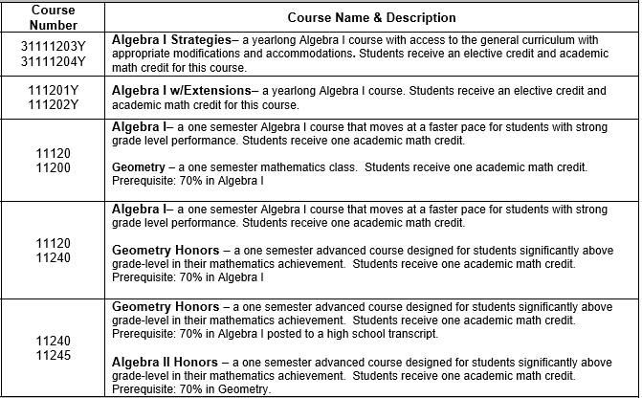
Choosing math ClassEs
Notes:
Choosing your Math Placement:
* LSC Algebra I is for students on an IEP.
* Algebra I with Extension is for the majority of Freshmen. Algebra I will be taught over the entire year (not semester).
* Algebra I (semester/block) is a more fast paced math class. Students will complete and entire credit of Algebra I in one semester and then move to Geometry in the spring.
** Any student that already has an Algebra I credit will start with Geometry first semster. The Algebra I credit MUST be posted on an actual high school transcript. A studnet who took Algebra I at an elementary school cannot skip to Geometry without that credit posted.

Slide 13
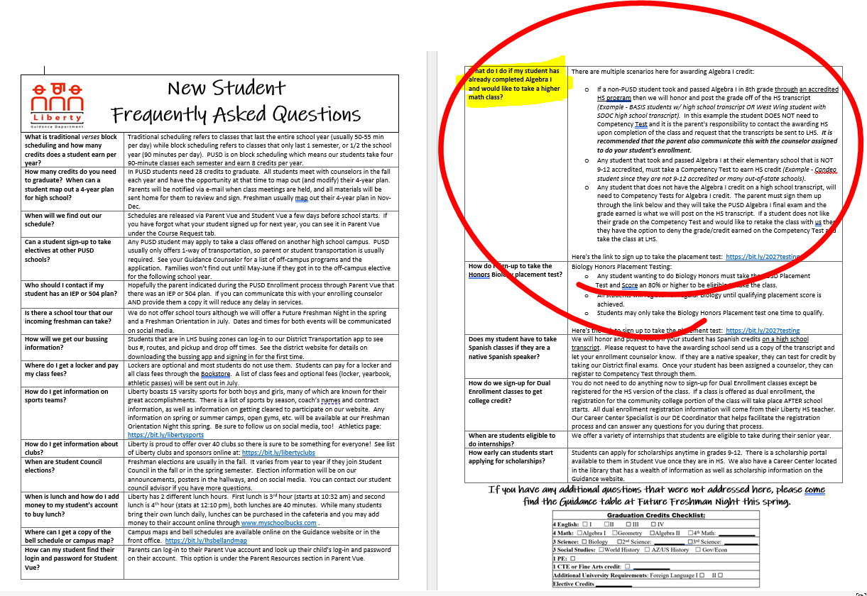
What if my child has already taken Algebra I in 8th grade?
https://bit.ly/LHS2027testing

Slide 14
Choosing A Science CLASS
If you want to do Honors Biology,
you need to register to test here:
https://bit.ly/LHS2027testing
Notes:
Choosing your Science Placement:
* Biology is the placement for most of our freshmen.
* Biology Honors is for students that are accelerated in science and math. A placement test is REQUIRED, talk to your Enrollment Counselor to get signed up if your student would like to test.

Slide 15
choosing p.e.
Notes:
Please mark one:
* AFJROTC if at another PUSD High School and it requires an application and you must provide transportation. Please e-mail your Enrollment Counselor if you need the Co-enrollment Application.

Slide 16
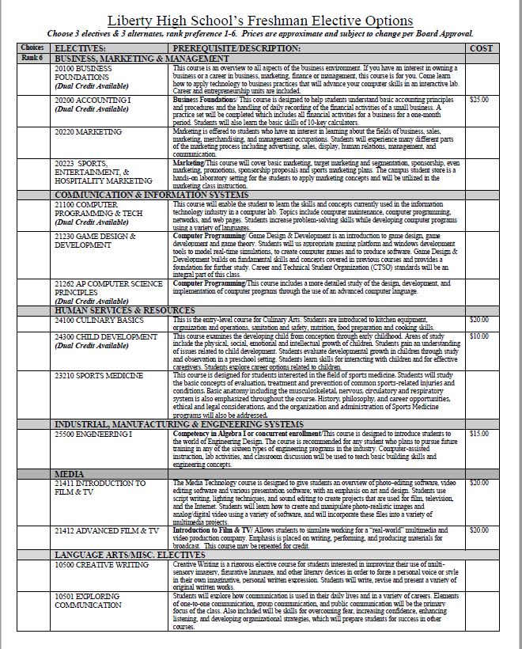
Choosing Electives
Most students will get 3 electives.
Choose 3 electives and 3 alternates. List those in preference order on the pre-registration form.
Choose what’s BEST FOR YOU! Think about your career interests!
Notes:
Please be sure you check the requirements for each electives. Read carefully.

Slide 17
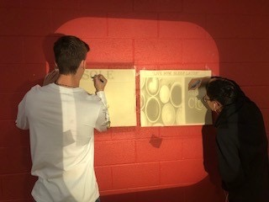
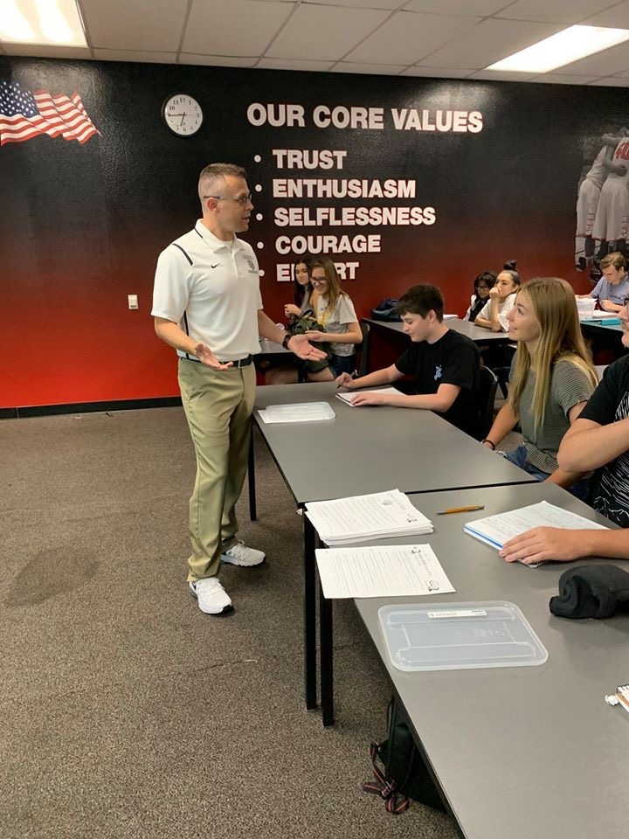
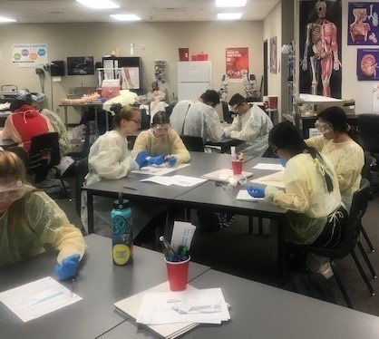
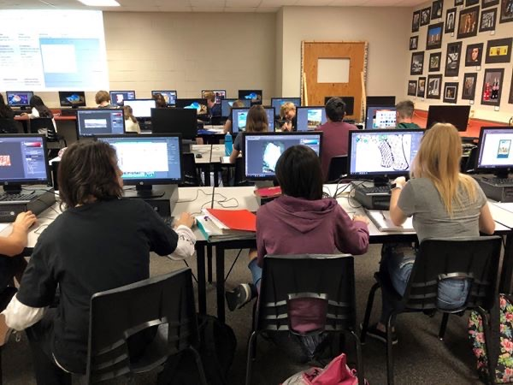
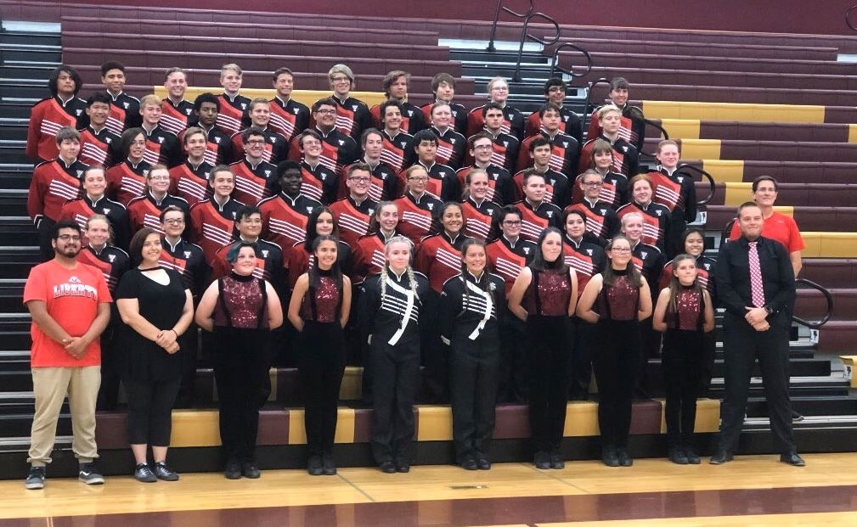
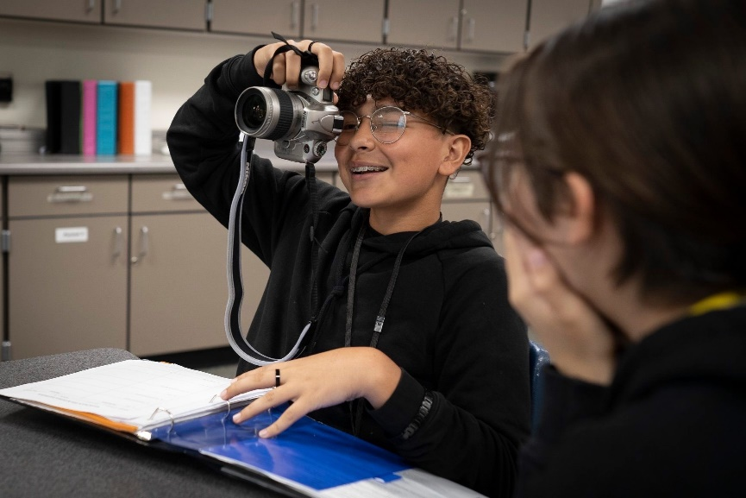
Choosing Electives
World Language classes are difficult and should be taken in consecutive semesters.
If you choose to take your world language freshmen year you must write down Spanish I AND II on the registration form.
Athletes - all Weight Training classes... Please list the sport on form.
(Ex – Weight Training – football)
Notes:
World Language is required for University admission but not for graduation. A student can take their world language credits (2) during any year but they must take BOTH I and II in the same year. If a freshmen decides to take world langauge they must list Spanish I and Spanish II on their registration form and it will take up TWO lines.
If you are an athlete, your sport May have a weight training class that is highly encouraged. This includes football, wrestling, baseball and basketball. If you plan to play one of those sports and want to be in that weight training section please write down Advance Weight training and the actual sport on one of lines on your registration form.

Slide 18
Make it a GREAT year!
Attendance is very IMPORTANT!
School times – 7:20am - 2:20pm
Schedules will show in StudentVue right before school starts.
Attend Freshmen Orientationa few days before school starts - TBD

Slide 19
Make it a GREAT year!
If you have credits to transfer on a high school transcript, please make sure we get an official copy at the end of the year.
Parents need to request to have the “Official Transcript” sent directly to Liberty High School. Please contact the other high school to have those sent to us.

Slide 20
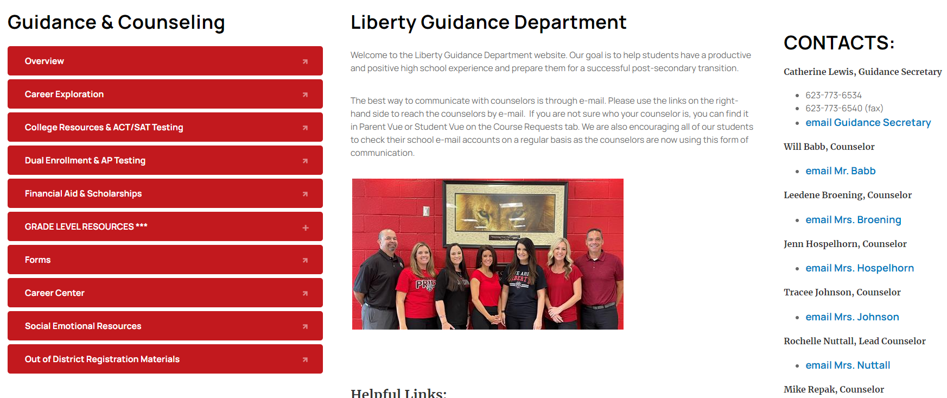
Online Resources
https://bit.ly/LibertyGuidance

Slide 21
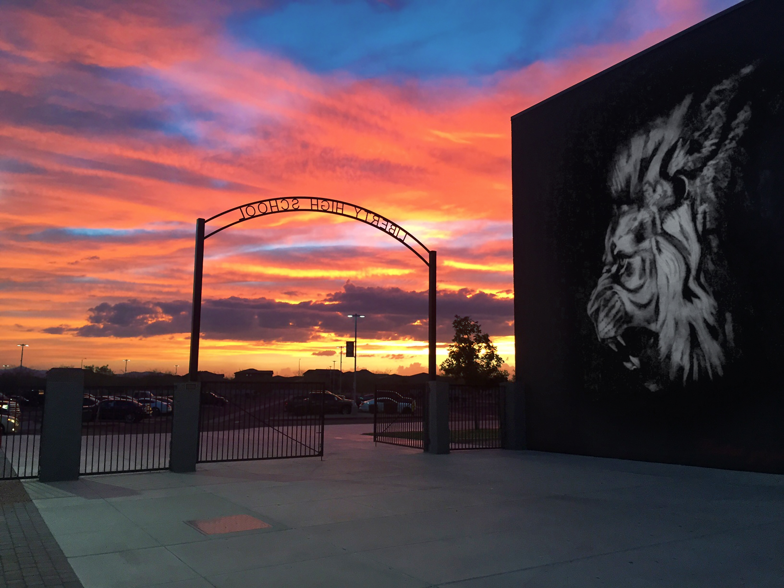
Thank-you for registering today. We look forward to having you on our campus to continue our rich academic traditions.
When you are done with filling out your green registration form completely (both sides), you can turn it in to a Counselor and you are free to leave.

